Slide 1


K.RAMAKRISHNAN COLLEGE OF TECHNOLOGY (AUTONOMOUS), TRICHY
STUDENT MANAGEMENT USING LINKED LIST
PRESENTED BY
PRIYADHARSHINI N
ME2341
Guided by
Mrs. S.GAYATHRI.M.E.,

Slide 2
PRESENTATION OVERVIEW
PROJECT INTRODUCTION
PROJECT OBJECTIVE
PROBLEM STATEMENT
LIBRARIES USED
EXISTING SYSTEM
PROPOSED SYSTEM
BLOCK DIAGRAM
MODULE DESCRIPTION
CONCLUSION AND FUTURE ENHANCEMENT

Slide 3
PROJECT INTRODUCTION
👉 A linked list is a dynamic data structure where each element, called a node, contains student data and a reference to the next node.
👉 In student management, linked lists allow efficient insertion and deletion of student records.
👉 They are particularly useful because they can easily grow or shrink in size, unlike fixed-size arrays.
👉 they use more memory due to the pointers and require sequential access to traverse the list.

Slide 4
PROJECT OBJECTIVES
1.Dynamic Size Management
2.Efficient Insertions and Deletions
3.Memory Efficiency
4.Simplified Data Organization
5.Flexible Data Structure

Slide 5
PROBLEM STATEMENT
1.Insert new student records at the beginning, end, or at a specified position in the list.
2.Remove a student record from any position in the list.
3.Find and retrieve a student record based on unique identifiers such as student ID or name.
4.Traverse the linked list to display all student records in the order they appear.
5.Modify the details of an existing student record.

Slide 6
LIBRARIES USED
Python Standard Library: Only the built-in functionality is used for basic operations.
dataclasses: For defining the student data structure more
efficiently and cleanly
pandas: For managing and manipulating tabular data, which can be useful for exporting and analyzing student records.

Slide 7
EXISTING SYSTEM
1.Database Management Systems (DBMS) 👉SQL Databases,NoSQL Databases
2.Web Interface 👉 Frontend Technologies,Backend Technologies
3.Cloud Services 👉 Cloud Storage and Computing,SaaS Solutions
4.Features of Existing Systems 👉 Student Information Management,Course and Enrollment

Slide 8
DISADVANTAGES OF EXISTING SYSTEM
1.Cost
2.Complexity
3.Customization
4.Data Privacy

Slide 9
PROPOSED SYSTEM
1.The proposed student management system utilizing a linked list aims to provide an efficient and dynamic way to handle student records.
2.Each student is represented by a node containing the student's ID, name, grade, and a pointer to the next node.
3.The linked list allows for flexible and efficient insertions and deletions without the need for shifting elements, as would be required in an array.
4.This design ensures that the system can dynamically adjust to varying numbers of student records, maintain high performance for core operations, and provide an easy-to-maintain and extend solution for student management.

Slide 10
ADVANTAGES OF PROPOSED SYSTEM
•Dynamic Size Management
•Efficient Insertions and Deletions
•Memory Usage
•Simplified Data Organization
•Flexibility
•Easy to Implement
•Scalability
•Minimal External Dependencies
•Improved Performance for Specific Operations

Slide 11
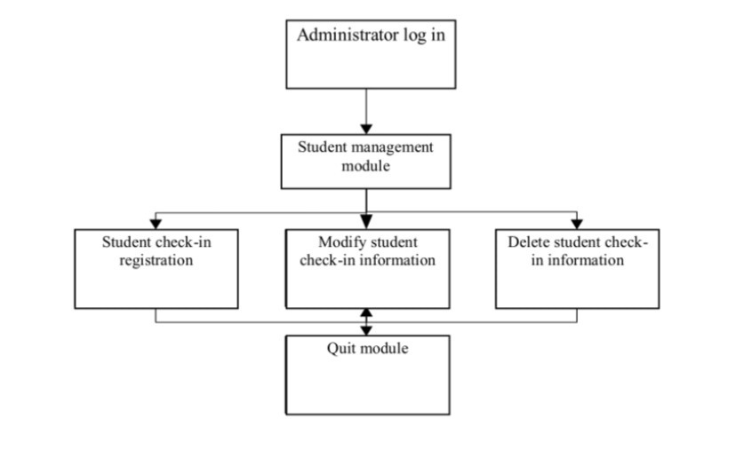
BLOCK DIAGRAM
.

Slide 12
Module Description
The module will provide functionalities to manage student records using a singly linked list. Each node in the linked list will represent a student and will contain fields such as student ID, name, and grade. The module will support operations like adding, removing, updating, and searching for students.

Slide 13
CONCLUSION AND FUTURE ENHANCEMENT
In conclusion, the student management system implemented using a linked list provides an efficient and dynamic way to handle student records. The linked list data structure allows for easy insertion, deletion, and updating of student information. The interactive text-based interface ensures that users can manage student data intuitively and effectively.

Slide 14
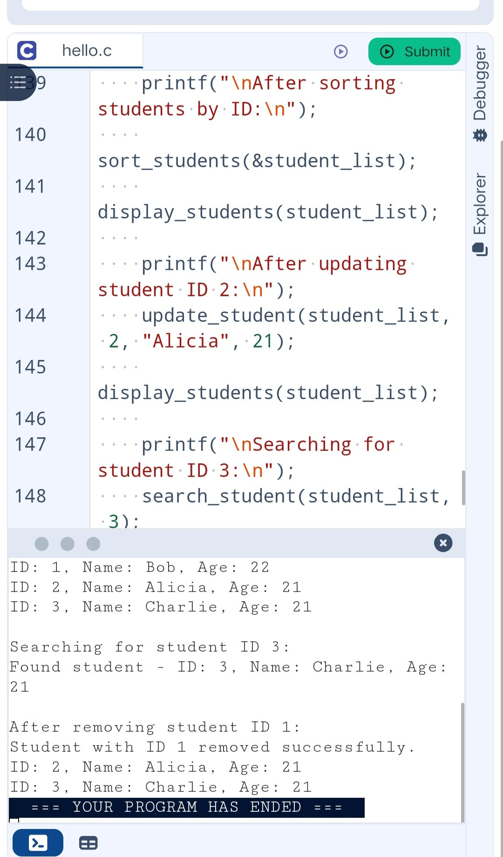
output

Slide 15
THANK YOU

